Slide 1
IoPAS summer student program -final report
Student : Chih-Hsiang Yeh
National Central University
Academia sinica
PI: Henry Tsz-King Wong

Slide 2
Outline
1.The related topics:
a. Gravitational wave b. statistics
(use the most reference from other Professor’s powerpoint from workshop or summer school)
2.Some interesting challenge for LIGO
3.Some new ideas
4.Conclusion
5.Reference

Slide 3
Summer school and workshop
This summer I participate in many summer school and workshop:
1.Summer Mini-School of Gravitational Wave
（TGWG)
2.AMO Physics Summer School
(AMO: atom , molecule, optics)
3.Summer School on Gravity, Fields and Strings
(This week in NTU in Astro-Math buliding,R440)
4.Workshop on hadron physics & QCD
5.Workshop Dark matter at LHC
**Actually , summer school is easy to understand than workshop because they want everyone know, workshop is for profession, although much time can absorb half to two over third*

Slide 4
1.The related topics
Gravitational wave
Statistics
**I will use the ppt that I see that easy to understand to talk and summary

Slide 5
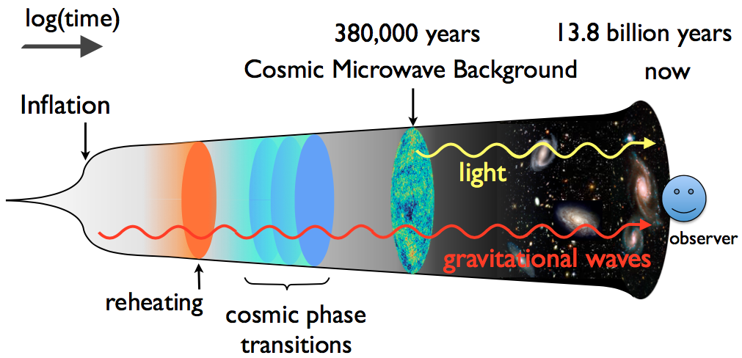
a. Gravitational Wave related
We can use picture to see the promising of GW

Slide 6
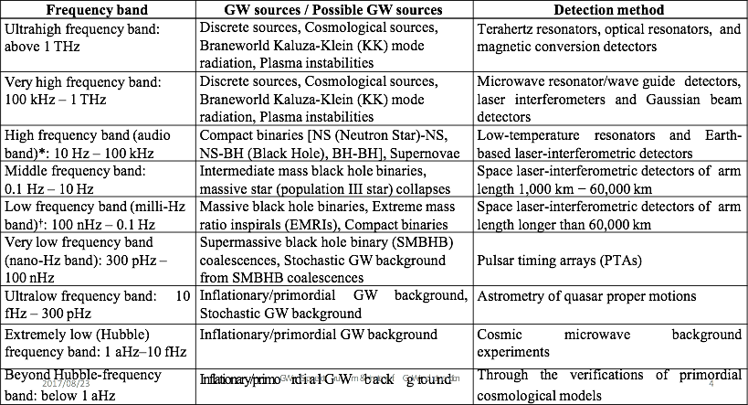
a. Gravitational Wave related
1.

Slide 7
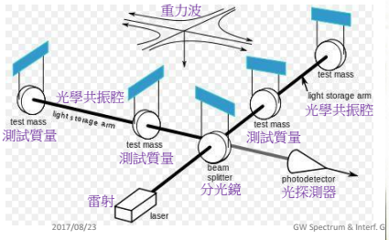
a. Gravitational Wave related
1.Michelson interference
2.Laser stabilization (PID)
3.Mirror calibration(NTHU)

Slide 8
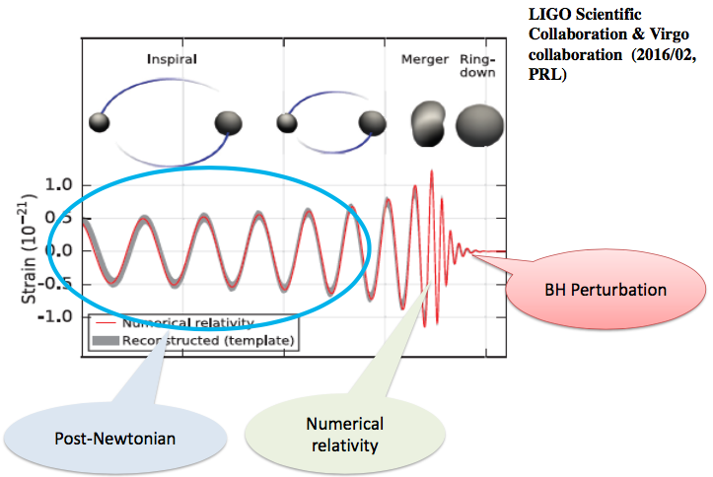
a. Gravitational Wave related

Slide 9
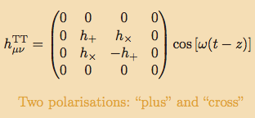

a. Gravitational Wave related

Slide 10
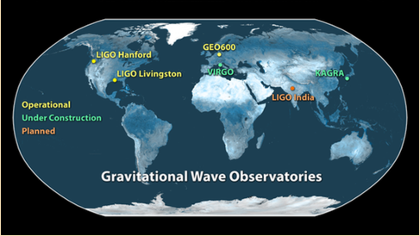
a. Gravitational Wave related
Now want to built more LIGO-like interference to sure the signal and location about event

Slide 11
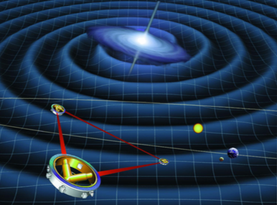
a. Gravitational Wave related
From universe, can minus more noise and deep traveling

Slide 12
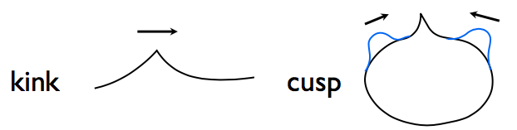
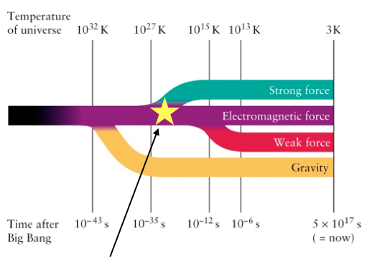
a. Gravitational Wave related

Slide 13
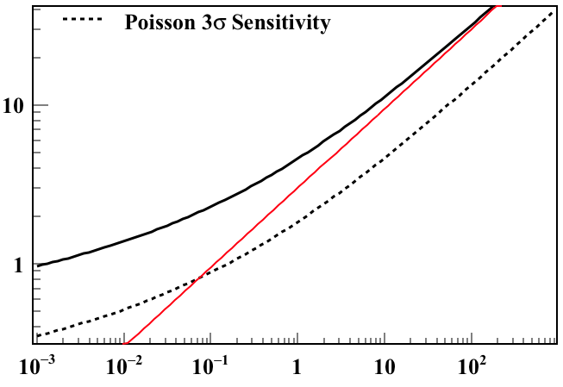
b. Statistics
Before and after the experiment we need to expect how much event we want to see

Slide 14
2.Some interesting problems-LIGO challenge
-What the scale about the light difference and location difference(test mass)?
-Light change scale is different from location
-Different effect
-Light->Red shift
-location->Metric tensor itself
-Is that chirp the real signal ? not from the same noise?
-Questionable mirror isolation?
tolerances of almost one angstrom (1Å)
-a billion times larger than the predicted size of gravitational waves
-include in random error(system error)->problem precisely measure

Slide 15
3.Some new ideas –produce GW that can be measured
1.Use the GR concept –
-Gravitation propagation can’t faster than light speed
2.Use Michelson interference
3.Use the high energy field to form the black hole -
-Laser could possible to do
4.We can produce the Gravitational wave by ourselves and possible to measure.
**Actually we can produce in our lifetime, But the scale is too too small to measure, so I think we can use other way to produce**

Slide 16
4.Conclusion
1.Gravitational wave is the promising program
2.Many problems like dark matter or other universe problem want to through this spectrum to solve
3.Behind and after experiment are there own statistics problem, and we need to see them carefully.
4.Every time we think about the experiment, we need to carefully to write down the detail to face the challenge.

Slide 17
Thanks
1.Thanks to teacher for giving us the opportunity to stay at IoPAS to study in summer vacation, I think most of the experience that is precious.
2.Have the nice day and nice future for everyone!
Thanks and see you!

Slide 18
5.Reference
1.TGWG mini-school
http://taipeigravitationalwavegroup.weebly.com/mini-school.html
2.AMO summer school
http://phys.cts.nthu.edu.tw/actnews/intro.php?Sn=353&OSn=759
3.Summer School on Gravity, Fields and Strings
http://phys.cts.nthu.edu.tw/actnews/content.php?Sn=361
4.Hadron physics & QCD
http://www.phys.sinica.edu.tw/QCD2017/index.php?id=2&fid=2
5.Dark Matter at LHC
http://phys.cts.nthu.edu.tw/actnews/?Sn=354

